Slide 1

Hadoop Introduction

Slide 2
Problems
Big Data: high volume, velocity, variety.
Storing in Relational database is costly, time-consuming.

Slide 3
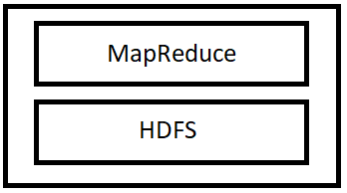
What is Hadoop?
An open-source framework.
MapReduce utilize to process data
HDFS is a file system that divide and store data in different computers.

Slide 4
Key attributes
Massive storage space
Low cost
Computing power
Scalability
Flexibility
Failure tolerance

Slide 5
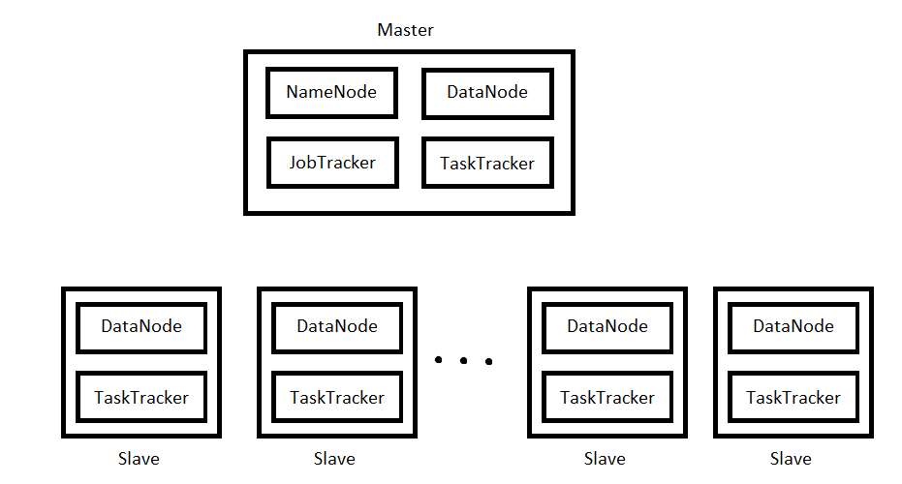
Hadoop cluster

Slide 6
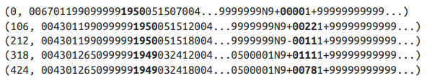
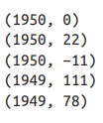
MapReduce mechanism
MapReduce has two main phases: Map phase and Reduce phase
Input of Map:
Output of Map:

Slide 7


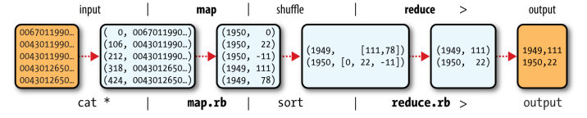
MapReduce mechanism
Input of Reduce:
Output of Reduce:
Overall:
Map: (in_key, in_value) -> (out_key, intermediate_value)
Reduce: (out_key, intermediate_value) -> (output_list)

Slide 8
MapReduce in Hadoop
MapReduce is a job which consists of the input data, the MapReduce program and configuration info.
Hadoop runs it by dividing it into tasks.
JobTracker assigns task for TaskTrackers and re-assign task to other in case the node fail.

Slide 9
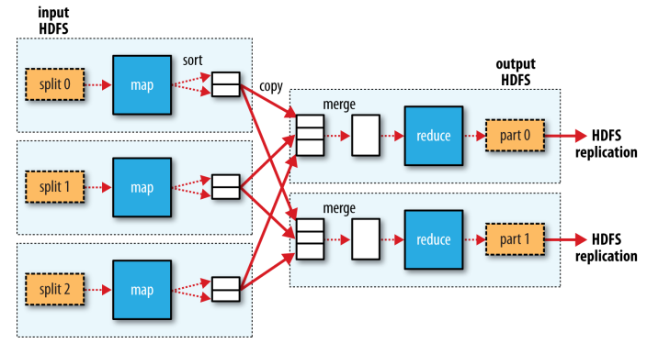
MapReduce in Hadoop
The input is divided splits, 128MB by default
The number of reduce tasks is varied from 0 to many:
In case of many reduce task, the output of each map will be partitioned into N parts for N reduce tasks

Slide 10
The Hadoop Distributed Filesystem (HDFS)
Blocks
NameNodes and DataNodes
Hadoop High Availability (HA)

Slide 11
Blocks
Files in HDFS are divided into blocks, 128 MB by default and can be changed.
Why?
File can be larger than single disk storage.
Simplify storage management.
Provide fault tolerance and availability (thanks to replications)

Slide 12
NameNodes and DataNodes
HDFS cluster operates in a master-worker pattern: a NameNode (master) and a handful of DataNodes (workers)
NameNode stores the namespace image and the edit log. Besides, it also stores the block locations temporarily.
Datanodes retrieve and store blocks when they are told to and report back periodically the lists of blocks they are storing.

Slide 13
Hadoop High Availability
Only one NameNode would cause SPOF. HA fixes it with a secondary NameNode.
Working in an active-standby configuration, if the first fails the second will take place and vice versa. To do this:
Share the edit note for synchronization.
Report from DataNodes send to both NameNodes
Clients must be configured to handle NameNode failover.
The secondary NameNode takes periodically checkpoint of the active one ‘s namespace

Slide 14
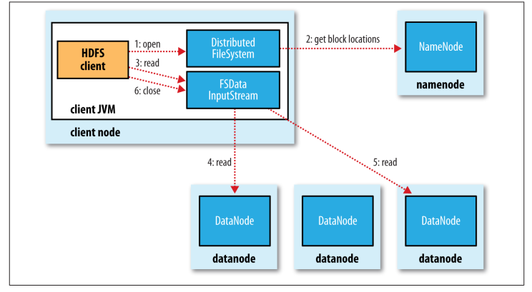
File Reading

Slide 15
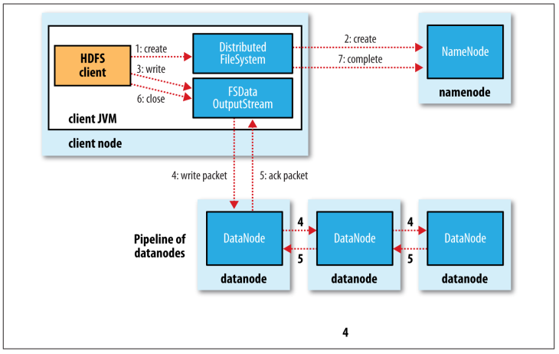
File Writing

Slide 16
References:
http://analyticstraining.com/2015/all-about-hadoop-the-what-how-and-why/
Book: Hadoop: The Definitive Guide

